Slide 1
Machine Learning
Gradient Descent Algorithm
Linear Regression
Non-Linear Regression
Logistic Regression
Decision Trees
Regression Trees
Classification Trees
Model complexity and ensemble models
Clustering Algorithms
K-Means
Hierarchical clustering
DB-Scan
Mean Shift
GMM
Support Vector Machine
Datasets
Breast Cancer Wisconsin
MIMIC-III
Framingham Heart Study
Alzheimer’s Disease Neuroimaging Initiative
Drug discovery
Microbiome
Deep Learning
MLP
CNN
CNN Arquitectures
Autoencoders
E: Transfer learning y fine tunning
Recurrent Neural Networks
VAE
GAN
Transformers
Diffusion Models
Paper + Implementation

Slide 2
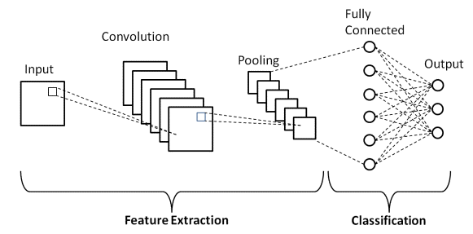
C12 – CNN architectures classification
my humble ML course

Slide 3
my humble ML course
LeNet-5

Slide 4
my humble ML course
AlexNet

Slide 5
my humble ML course
VGG-16

Slide 6
my humble ML course
Inception-V1

Slide 7
my humble ML course
ResNet-50

Slide 8
my humble ML course
Bibliography
https://towardsdatascience.com/5-most-well-known-cnn-architectures-visualized-af76f1f0065e
https://towardsdatascience.com/illustrated-10-cnn-architectures-95d78ace614d
https://uvadlc-notebooks.readthedocs.io/en/latest/tutorial_notebooks/tutorial5/Inception_ResNet_DenseNet.html
https://www.jeremyjordan.me/convnet-architectures/

